Slide 1

Will my Flight be delayed?
Project Update
Neel Iyer
April 4, 2017

Slide 2
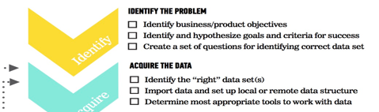

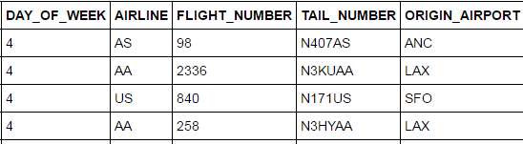
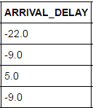
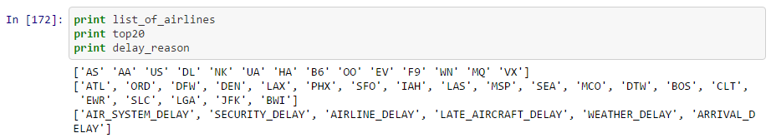
Questions
Acquire the Data
Can delay of a future flight be predicted based on a historical training set?
Do city of origin, hour of day, airline significantly contribute to delay?
Additional intuitive features – does size or age of aircraft impact delay? Maybe a Principal Component that includes them both, along with the Airline and city of origin?
Kaggle Flight Delay is the source of data
All US domestic flights in 2015
A second file with aircraft code and age
A third file with to identify a specific aircraft tail number to seating capacity

Slide 3
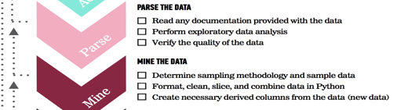
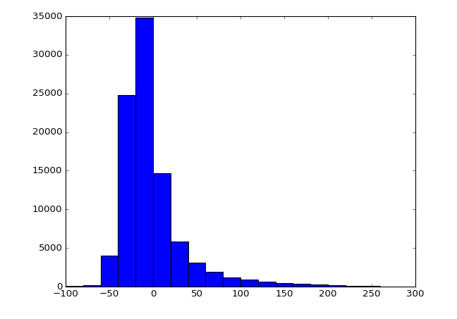
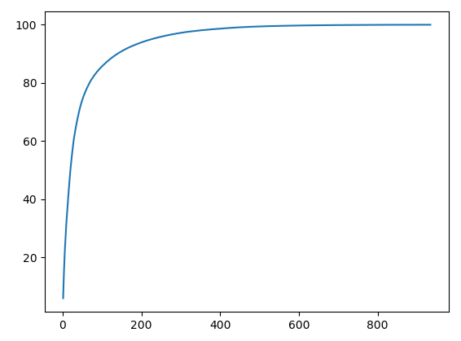
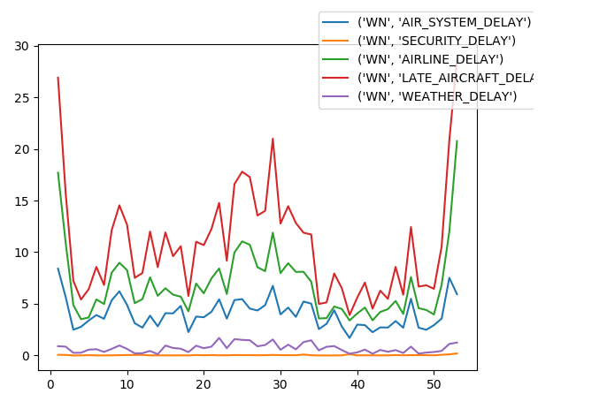
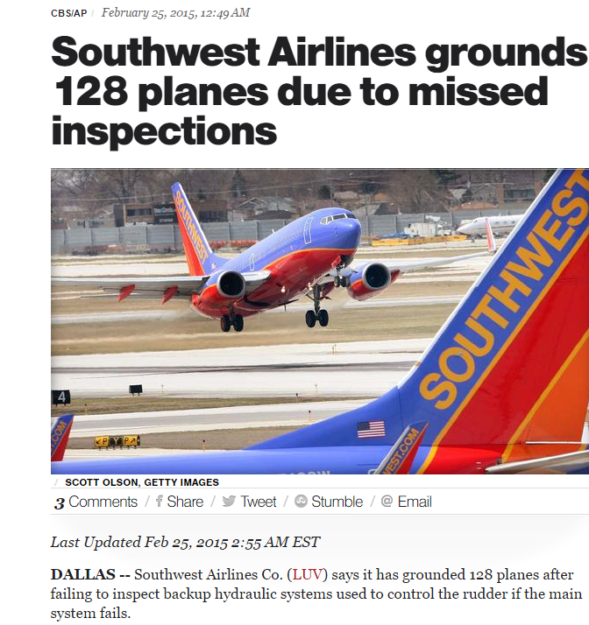
Histogram of Arrival Delay
SECURITY_DELAY only affects a small % of flights
First and last week of the year seem to be outliers
Summer months have higher than usual delays
Week 9 – Heavy delay due to maintenance issue
Common cause vs. special cause variation identification
Top 20 airports contribute to 50% of all flight departures
~2% of total scheduled flights are cancelled or diverted
Log transform may be needed
% of total flights
Count of airports by traffic
Arrival Delay (mins)
Southwest - % Delay by week for each reason
Week9
Week 29
% of flights delay
No abnormal cause seen from news articles – maybe just summer congestion?
Week

Slide 4
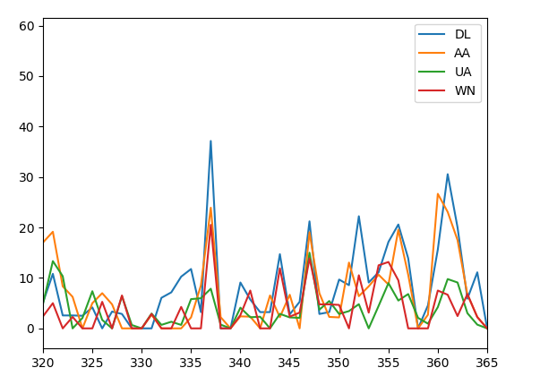
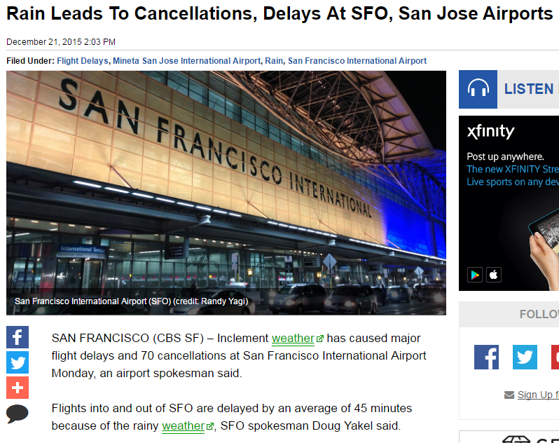
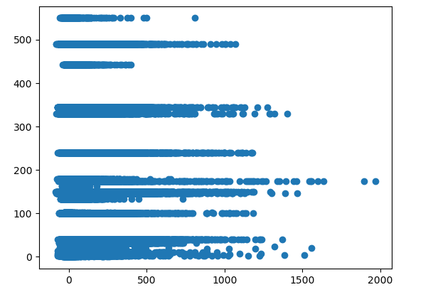
…continued
Dec 21, 2015
% delay at SFO for 4 major airlines
Should weather delays at SFO be considered normal or outlier? ➔ review predictor accuracy with and without Dec 21 data
% flights delayed
Day of Year
Scatter plot of aircraft capacity versus arrival delay
Are larger aircraft less likely to be delayed?
Lot of outliers in arrival delay, some > 16 hours! Why not cancel?
Capacity of aircraft (seats)
Arrival Delay (minutes)

Slide 5
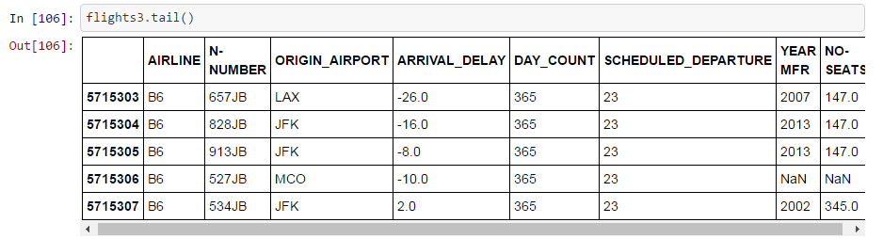
… continued
table2
table1
table3
Creating the final table
Some of the data cleanup steps:
Create new columns as a function of existing ones
Join tables on a common column name or index

Slide 6
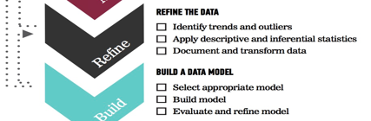
Next steps -
Try different models-
1) Multinomial logistic regression
2) Random Forest Classifier
Compare training set accuracy of each method
Optimize parameters using GridSearch
Lessons Learned-
For aggregration/summary results, ‘groupby’ is a faster alternative to ‘for loop’
It is important to seek and understand outliers

